Slide 1
Wines & Spirits 101
Enjoy responsively

Slide 2
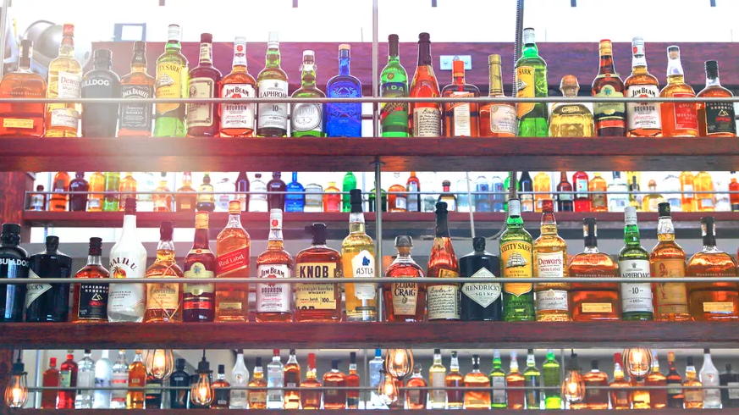
6 spirits in the world
Brandy 白兰地
Gin 金酒
Rum 朗姆酒
Tequila 龙舌兰
Vodka 伏特加
Whisky 威士忌

Slide 3
Brandy 白兰地
Color: Varies, light amber to rich ruby-brown
Region: Armagnac（雅文邑）and Cognac（干邑）regions of France, but brandy can be technically made anywhere
ABV: 40% ABV (for Cognac), higher for Armagnac
Aged: Varies
Made from: White wine grapes, Ugni Blanc (Cognac), Colombard, Baco Blanc, and Folle Blanche (Armagnac)
Commercial Examples: Courvoisier, Remy Martin, Hennessey, Gilles Brisson, Clos Martin, Darroze, Sempe, Janneau, Larressingle

Slide 4
Did you know?
制作酒桶的橡树，树龄都在100年以上，一颗树只能制作三只用于干邑陈酿的木桶。橡树在冬季砍伐，此时树液都在休眠，树干砍成木板不锯断，木板暴露在空气中不少于3年使其枯干，橡木桶在夏朗德的作坊中手工打造。
VS / Very Special: 酒龄不少于两年半
VSOP / Very Superior Old Pale: 酒龄不少于4年半
VVSOP / Grande Reserve: 年份不少于5年半
XO / Extra Old / Napoleon: 年份不少于6年半
干邑是一种混合型酒，因此我们所说的干邑年份指的是混合酒中最年轻的干邑。例如，“这款VS具有6年的味道。”这款酒，可能是由两年和10年的干邑混合而成，其味道近似于未经混合的6年干邑。”

Slide 5
Gin 金酒
Color: Clear
Region: Produced heavily in the U.K. but can be produced anywhere, historically from Holland; only 13 gins have “geographical indications”
ABV: Minimum 40% ABV
Aged: Possibly, 3 to 6 months if desired, but not necessary
Made from: Usually a grain mash (could be barley or corn), can be made from any mash to produce a neutral spirit that’s then infused with botanicals including juniper
Commercial Examples: Bombay Sapphire, Tanqueray, Ransom (Old Tom), Plymouth Gin, Berkshire Mountain Distiller’s Greylock Gin (U.S.), Dorothy Parker (U.S.)

Slide 6
Did you know?
生产酒精度不低于96%， 被完全净化，没有任何邪杂味。
纯净的优质金酒，给人冰爽的感觉，它可以减弱酒精的烧灼感。在英国，人们形容金酒“冷的像金属”。甜味是质量差的标志，它会掩盖酒精的缺点。
主要用途作为鸡尾酒的基酒：Dry Martini, Negroni, Gin & Tonic

Slide 7
Rum 朗姆酒
Color: Clear, light amber, Dark amber
Region: Rum can legally be distilled anywhere in the world, but it’s most commonly associated with places like Trinidad, Jamaica, Cuba, Guyana, Barbados, Mexico, etc.
ABV: 40% ABV minimum
Aging: Many, but not all, rums are aged
Commercial Examples: Ron Zacapa, Appleton, Foursquare, Bacardi, Mount Gay

